Slide 1
Co-regulation of NER repair factor expression
Tim Heinemann
Third TAC meeting
17.11.2014

Slide 2
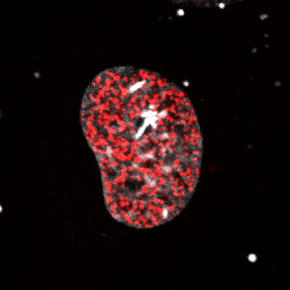
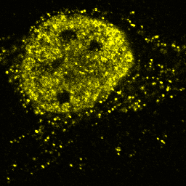
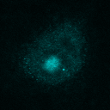
Properties of chromatin-associated processes
DNA replication
RNA transcription
Initiation
Termination
Process
DNA
RNA
DNA repair etc.
Protein

Slide 3
Properties of chromatin-associated processes
Multi-protein
Dynamic Exchange
Specific
I
II
I
II
I
II
?
III
IV
III
IV
III
IV
How do systems properties (fidelity, speed, timing,…) arise from the interplay of many components?
Which components control these properties and define their nature?
Notes:
Hypothesis: systems properties such as fidelity and speed arise from component and substrate inter

Slide 4
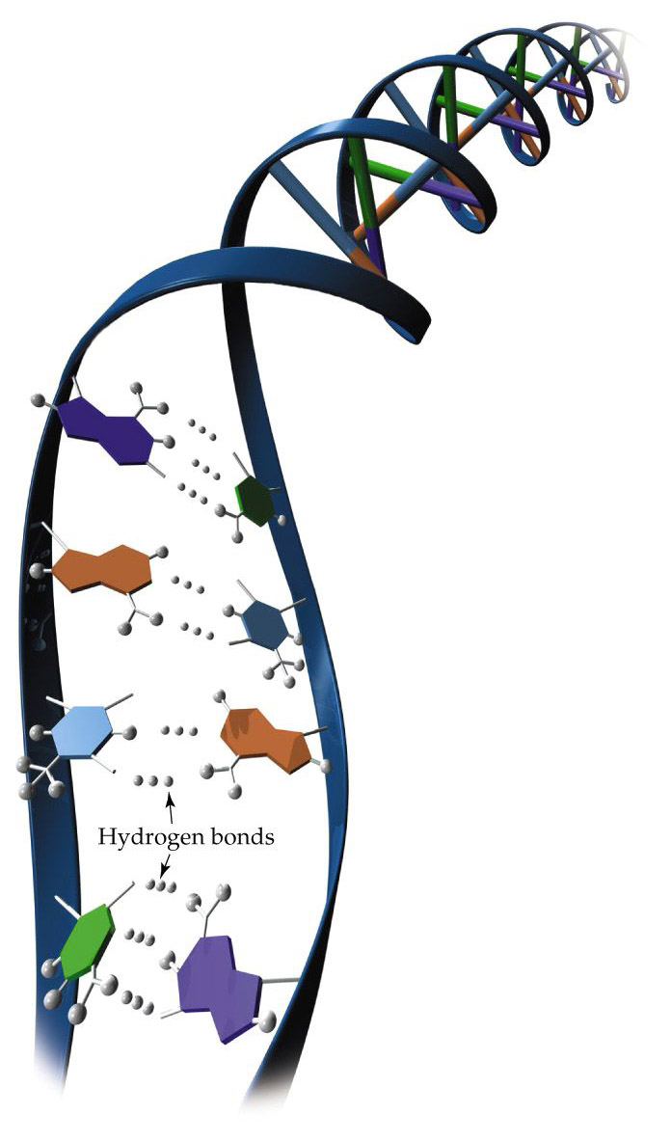
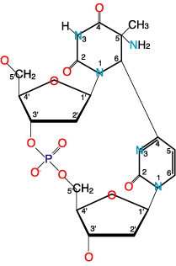
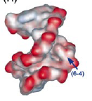
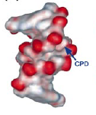
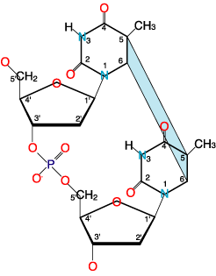
UV induced DNA damage photochemistry well understood: mostly Thymine-Thymine dimers
6-4 pyrimidine pyrimidone
photoproduct (6-4 PP)
UV light
bulky helix distortions
5-6 cyclobutane
pyrimidine dimer (CPD)
Notes:
Importance of NER becomes clear from what happens if NER is non-functional
- Accumulation of mutations lead to

Slide 5
Nucleotide Excision Repair (NER) as a paradigm for chromatin-associated processes
Exemplary reaction process comparable to other chromatin associated pathways
Multiple-protein driven: initiation, process execution with high fidelity, termination
Simple induction of DNA repair
UV-light introduces DNA lesions recognized by NER
Components identified
Factors and their functions during NER largely known
System non-essential for viability
Core proteins can be (entirely!) replaced by tagged counterparts
Kinetic information available!
Interaction of proteins with chromatin well researched

Slide 6
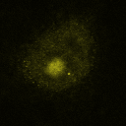
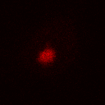

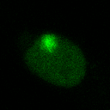
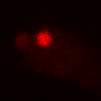
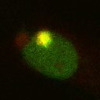
Direct readout for repaired DNA
HeLa
HeLa
XPC
EdU
Merge
5 µm
XP-C XPC-GFP
XPC-GFP
EdU
Merge
In collaboration with Paul Verbruggen (Amsterdam)

Slide 7

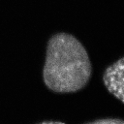
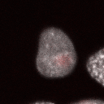
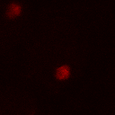
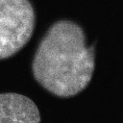
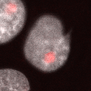
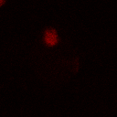
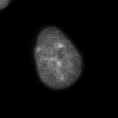
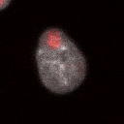
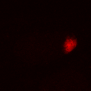
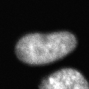
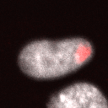
Slow repair with large cell-to-cell variability
30 min post-UV
(repaired DNA)
(Damage)
EdU
DAPI
Merge
5 µm
60 min post-UV
EdU
DAPI
Merge
120 min post-UV
τ ≈ 1.2 h
EdU
DAPI
Merge
180 min post-UV
EdU
DAPI
Merge

Slide 8
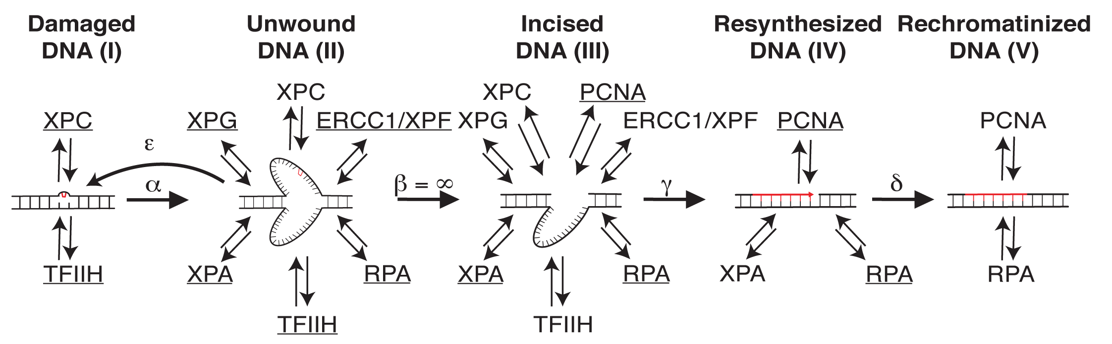
Kinetic modelling of NER
Luijsterburg, M. & Bornstaedt, G. et al. (2010) J. Cell Biol.
Notes:
Fit looks good – parameters are identifiable

Slide 9
Fast and random assembly accounts for slow rate of repair
Reversible binding of individual factors:
Slow reaction
Large variability
Notes:
Model Scheme auch gerne mal öfter später bringen…

Slide 10
Experimental validation of low XPC control over repair kinetic
Response coefficient =
Relative change in systems property
Rel. change in protein concentration
r = 0.29 (0.16,0.41); p < 0.001
m = 0.46
r = 0.18 (0.03,0.31); p < 0.001
m = 0.31
Notes:
But then – what does control the rate of repair…?
We asked – Can we simulate a random cell that matched the measured data?

Slide 11
Simultaneous measurement of two repair proteins allows cross-correlation analysis
DAPI
dXPC
iXPC
EdU
 | XPC | XPB | XPA | XPF | RPA
XPC | x | x | x | x | x
XPB |  | - | - | x | -
XPA |  |  | - | x | x
XPF |  |  |  | - | -
RPA |  |  |  |  | -
In collaboration with Simon Eck (AG Rohr)

Slide 12
Measurement error smaller than natural variability
Natural variability
Measurement error

Slide 13
NER factors are strongly positively correlated

Slide 14
Cross-correlation is repair independent

Slide 15
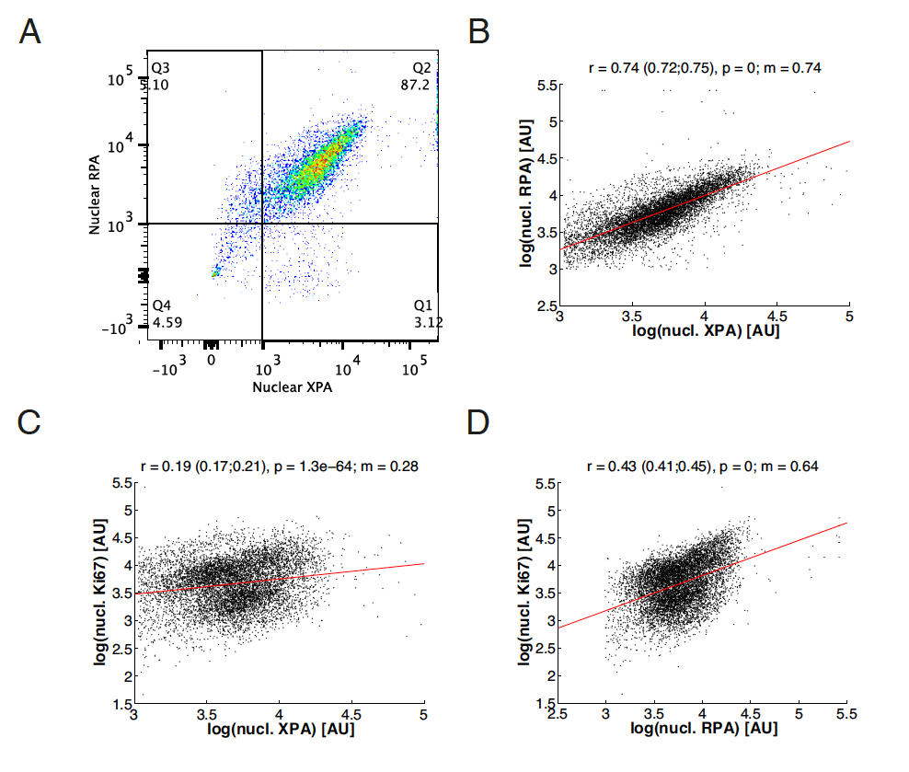
Reduced cross-correlation between NER factors and Ki67
In collaboration with Martin Teichert (AG Augustin)

Slide 16
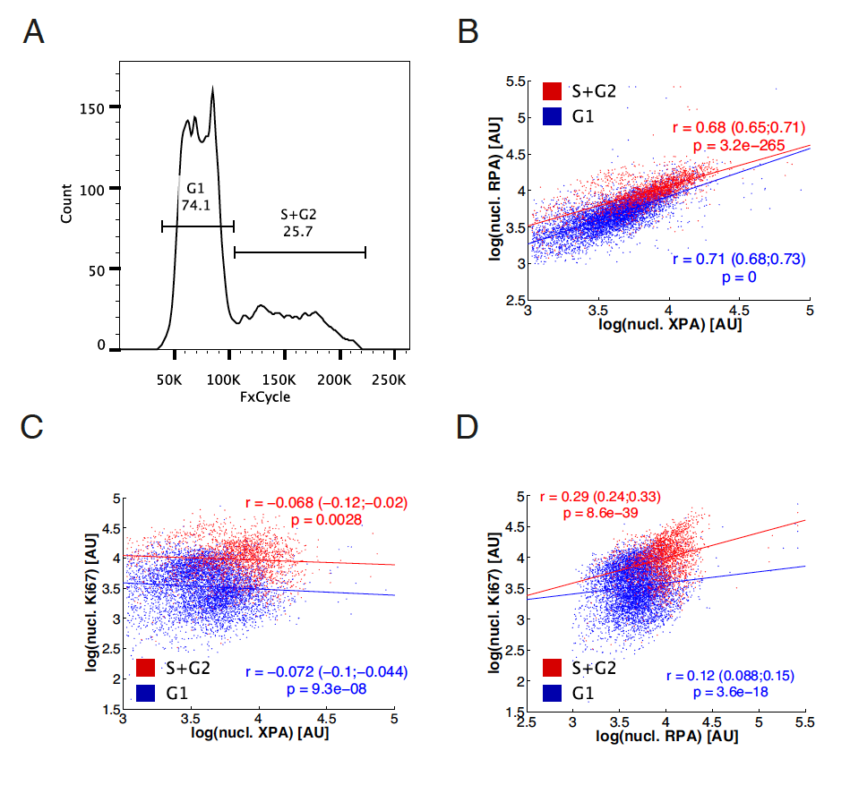
Positive correlation between cell cycle and NER factor expression

Slide 17
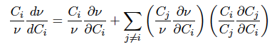
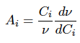
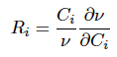
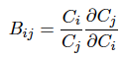
Response coefficients not uniquely identifiable
r = 0.18 (0.03,0.31); p < 0.001
m = 0.31

Slide 18
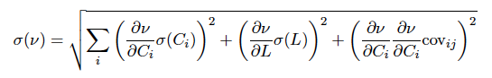
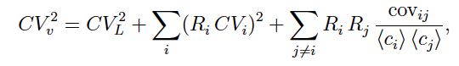
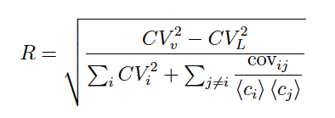
Average response remains small

Slide 19
Conclusions
Strong positive correlation of nuclear NER factor concentration
Correlation is independent of repair and the cell cycle progression
Correlation prevents unique identifiability of response coefficients

Slide 20
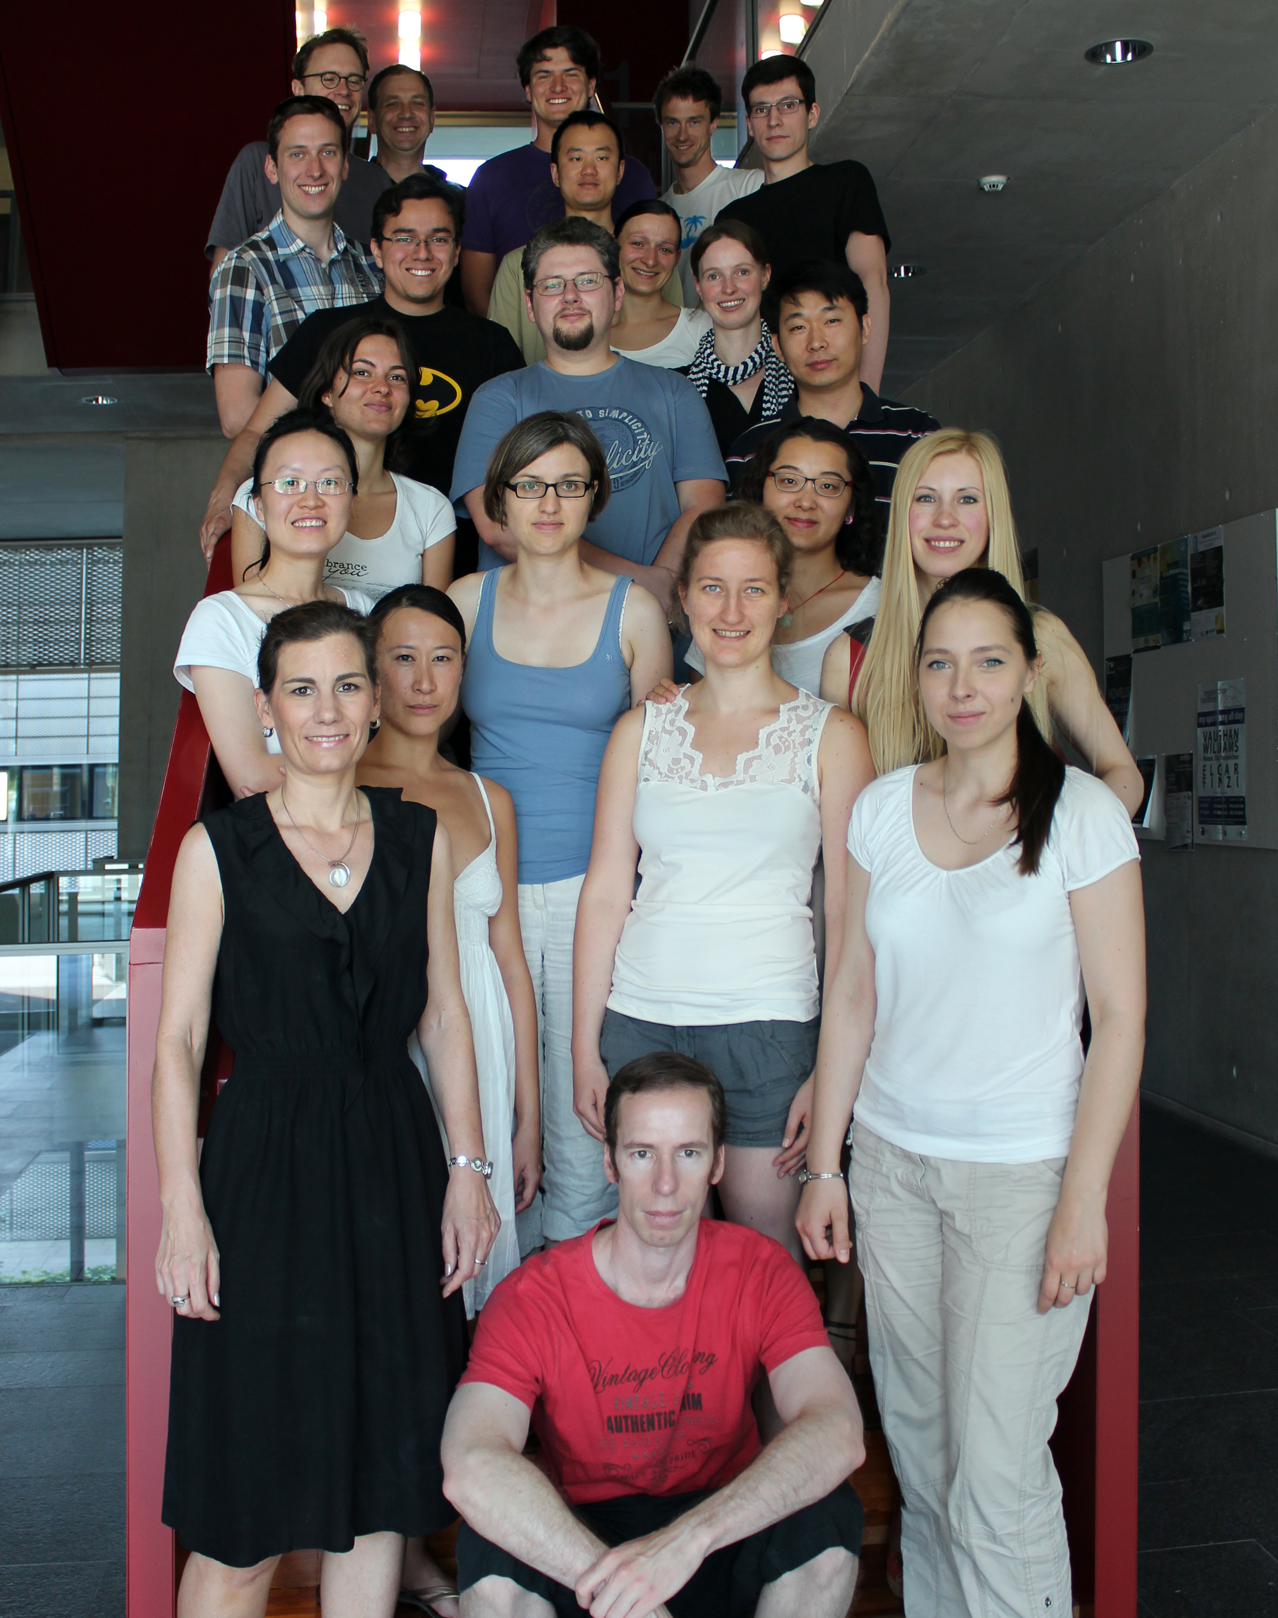

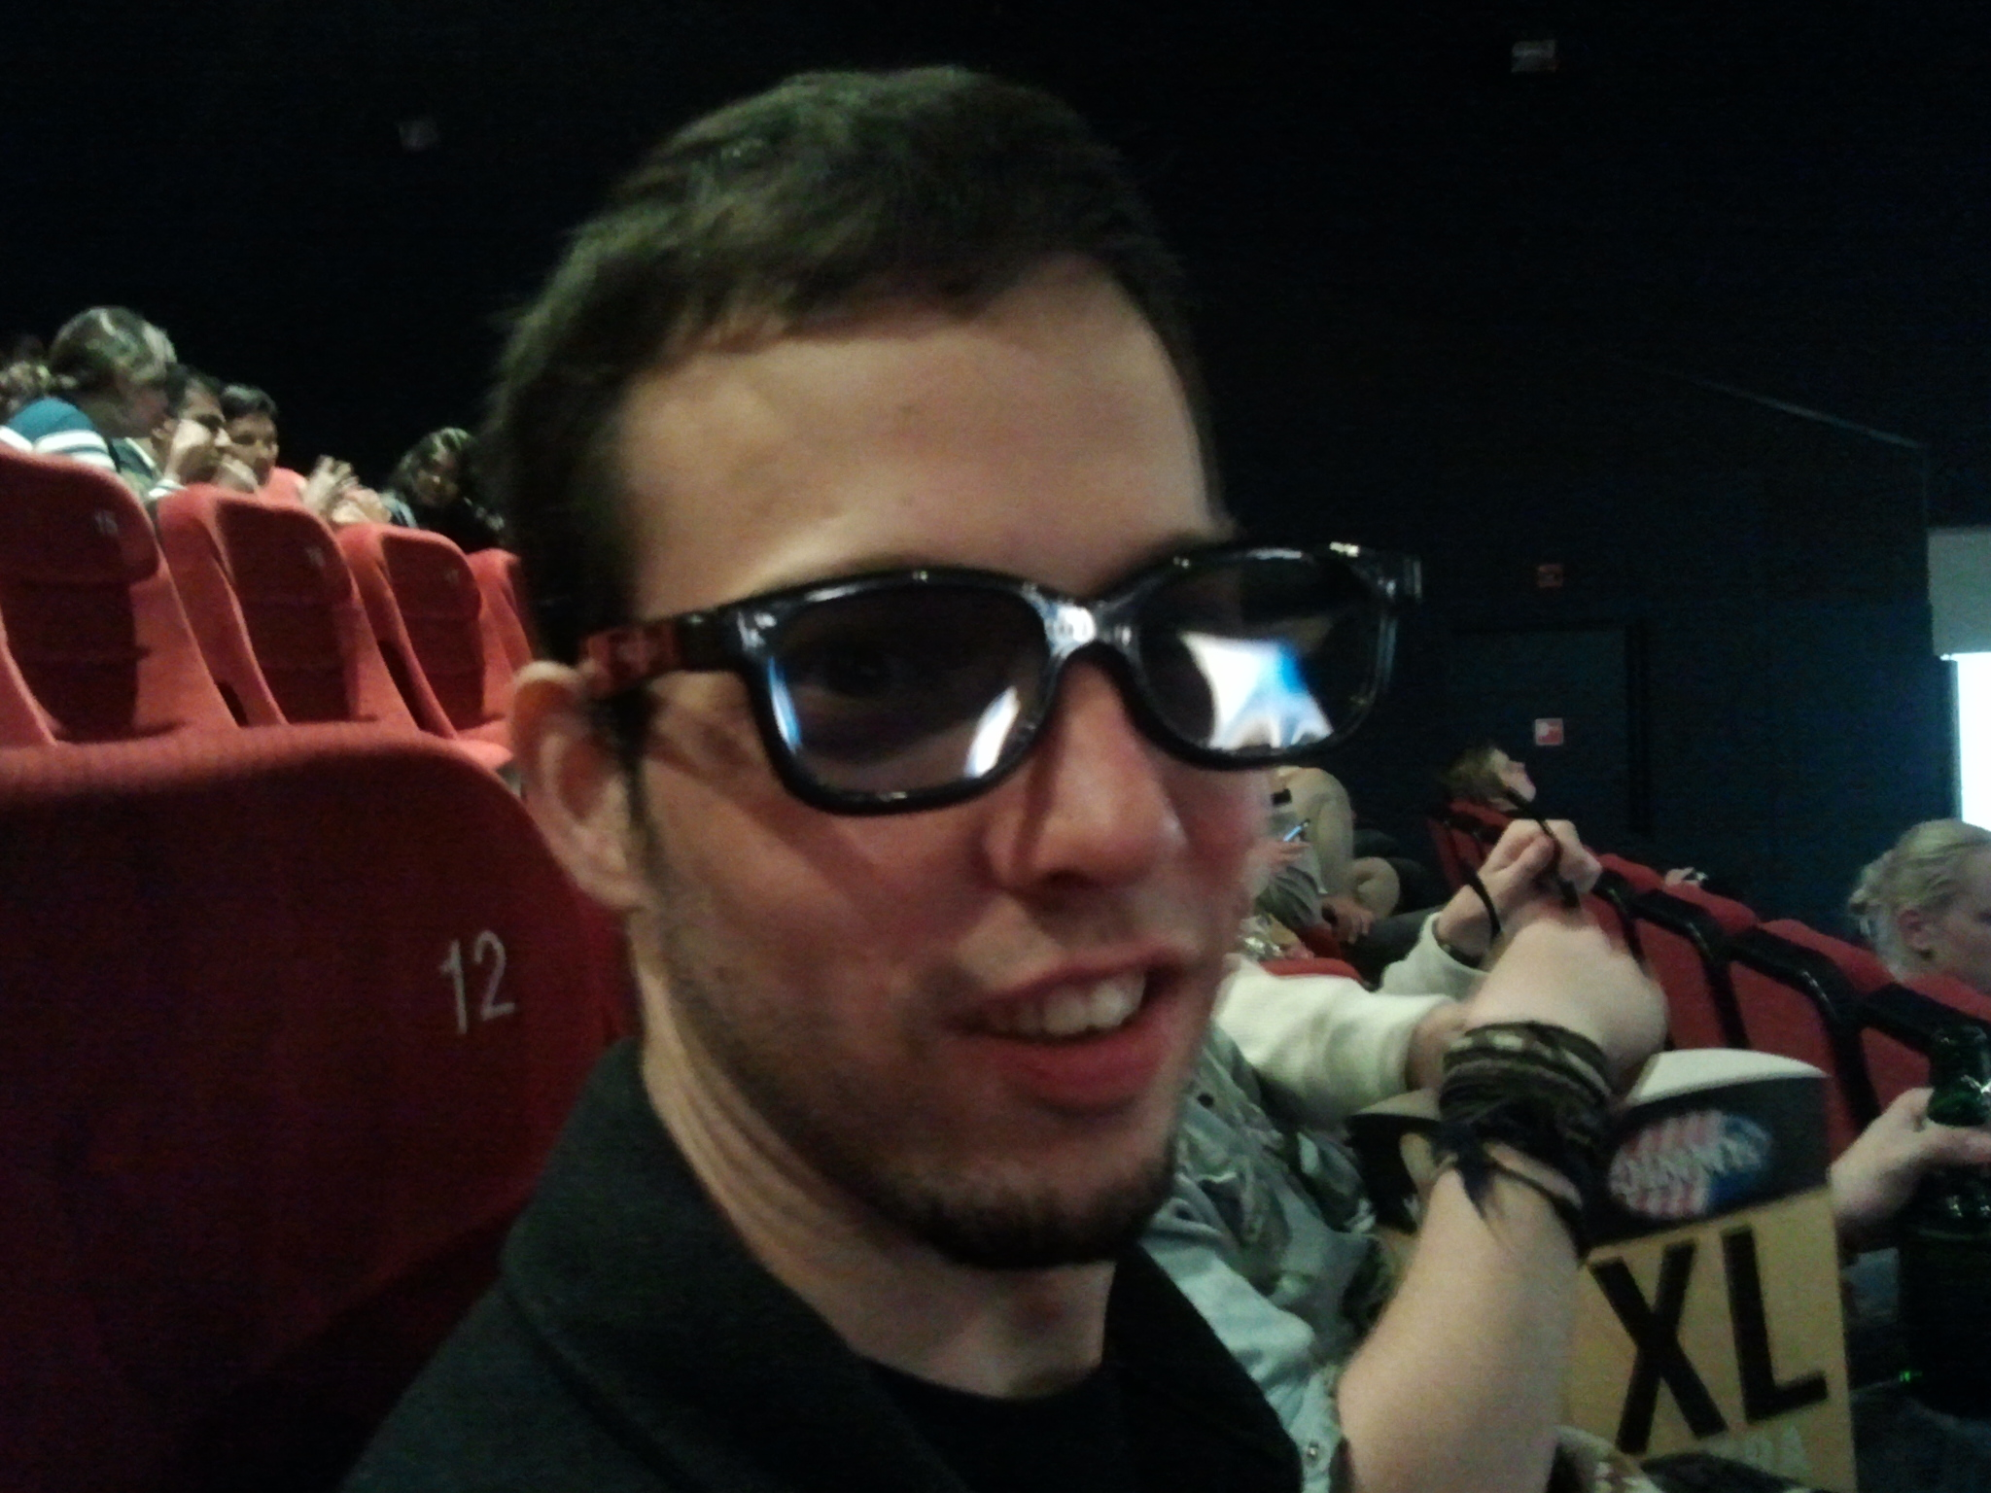
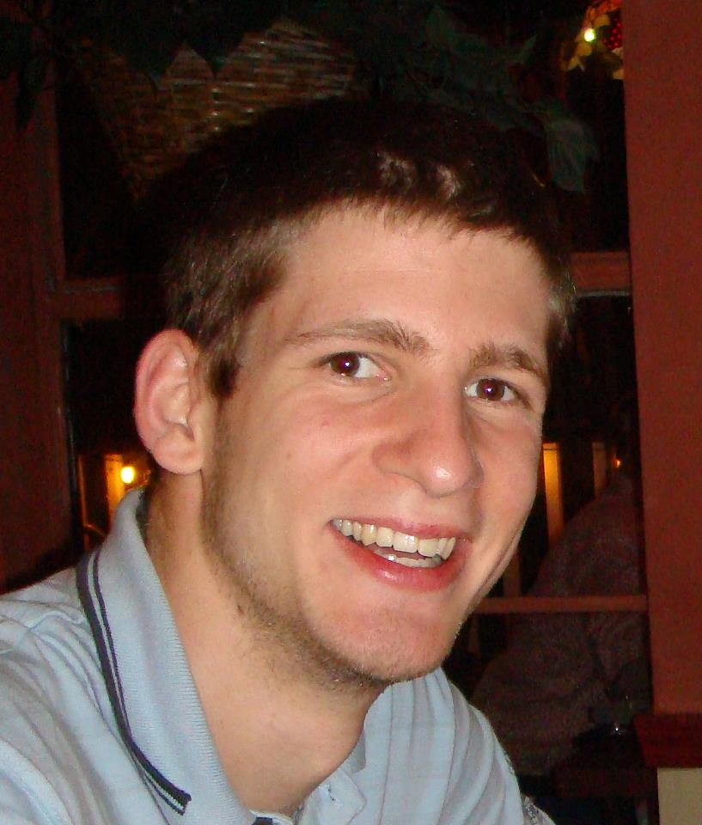
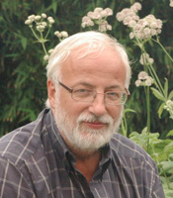
Thank you for your attention!
Simon Eck
Paul Verbruggen
Martin Teichert
Roel van Driel

